Slide 1



Slide 2

# | Name | ID | Group
1 | Donia Yasser Saied | 20201230 | S5
2 | Sarah Tarek Abd El-Alim | 20201087 | S5
3 | Reham Ashraf Fathy | 20201079 | S5
4 | Aziz Samy Aziz | 20200327 | S5
5 | Mohammed Samy Hmam | 20190442 | S5
6 | Belal Ahmed Gharib | 20200769 | S5
Project contact member email : st473614@gmail.com
Project contact member mobile : 01141723072
TA. <Eng: Ahmed Abd El-Aziz>

Slide 3

System Requirements Specification
Scope
Creating a comprehensive solution for both employers and job seekers.
Features:
User authentication and personalized profiles create and manage for job seekers.
Job listings categorized by industries, positions, and locations.
Detailed information about job listings including company profiles, job descriptions, and application instructions.
Job apply, application submission, and feedback tracking.
Search and filter jobs.
Integration with a messaging system for direct communication between employers and applicants.
Support a mobile responsive design to enable users to engage with the platform on various devices.
Allowing users to stay connected to job opportunities while on the move.
Purpose
The system should be user-friendly system and aim to streamline the Job Search process, providing a comprehensive solution for both applicants and employers.
Facilitate effective and direct communication between employers and applicants.
Help job seekers to find Varies job opportunities relevant to their skills.

Slide 4
System Requirements Specification
Audience
Definition and abbreviation
Job Seekers: Individuals looking for job opportunities
Employers: Organizations or companies that want to hire qualified candidates for their available jobs.
IDE (Integrated Development Environment).
HTML (Hypertext Markup Language).
CSS (Cascading Style Sheets).
JS (JavaScript)
JSON (JavaScript Object Notation
UI (User Interface).
UX (User Experience).
SQL (Structured Query Language).

Slide 5
System Overview
Problem Statement
Proposed Solution
Limited reach.
Manual effort.
Time consuming.
Lack of transparency.
Advanced Search and Filtering.
Efficient Application Process.
Mobile Accessibility.
Transparency in Job Postings.
Application Status.
Review Application .
Communication Tools .

Slide 6
Assumptions and/or constraints
Assumption
Constrain
Internet Connectivity.
User Device.
Data Accuracy.
User Engagement.
Time Constraints.
Budget Constraints.
Security Constraints.
Scalability Constraints.
Legal and Regulatory Compliance.
Compatibility Constraints.
Organizational Constraints.

Slide 7
System Requirements
Functional Requirements
Job Seekers:
Create a profile.
Manage profile.
Search about a job.
Exploring diverse job listings.
Apply for jobs.
Receive feedback.
Notify of relevant job openings.
Communicate with employer.
Employer :
Create job postings.
Manage job postings.
Review applicant profile.
Communicate with candidates.
Non-Functional Requirements
Performance.
Reliability.
Usability.
Maintainability.
Compatibility.

Slide 8
Use Case Model
Use Case Diagram & narratives

Slide 9
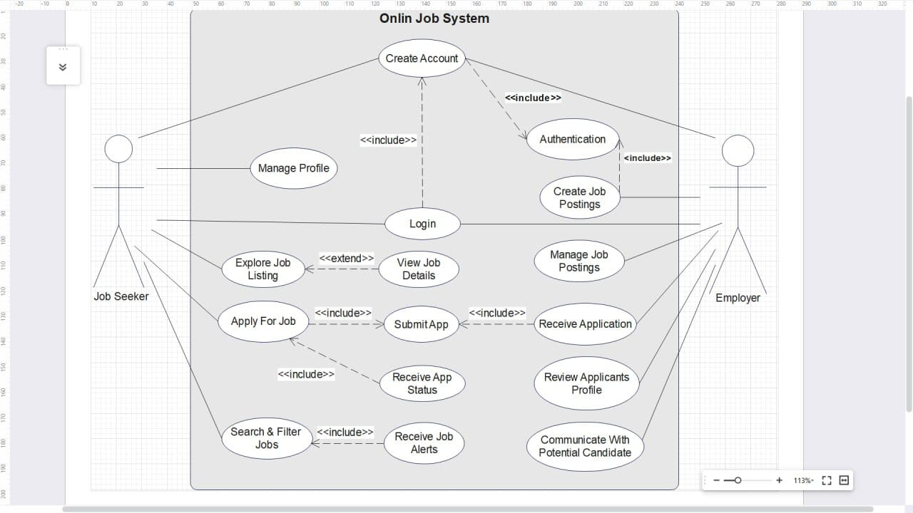

Slide 10
Name : Apply for job
Actor :Job Seeker
Entry Condition : (1) He should be registered in the system, (2) His profile should be established (3) job information should be provided | 2
Exit Condition :(1) He applied for his desired job, (2) A feedback on the application status is provided from the recruiter
Flow Of Events :1-job seeker creates an account, 2- System checks the authentication, 3- He edits and manages its profile, 4- He explores job listing and its details using searching and filtering, 5- He applies job in which he is interested 6- Submitting the app 7 – Receiving app status
Alternative Events :If he remembered that he entered any wrong information in the submitted app, then he would return to step 4 up to the last step

Slide 11
Name : Communicate with potential candidate
Actor : Employer
Entry Condition : (1) He should create a job post and manage it (2) He should be received applications from job seekers and reviewed their profiles
Exit Condition :­­ If he found the candidate as appropriate person for the announced position
Flow Of Events : (1) He creates an account, (2) System checks the authentication, (3) Company profile which he represents should be established (4) He should create a job post then manage it after system authentication acceptance (5) He should be received applications from job seekers and checked them (6) He should be reviewed their profiles (7) finally ,He should communicate with whom he finds appropriate for that position
Alternative Events : if the applicant ignores the recruiter ,recruiter returns to step 5 up to final step

Slide 12
Sequence Diagram
Apply For Job & Review Application

Slide 13
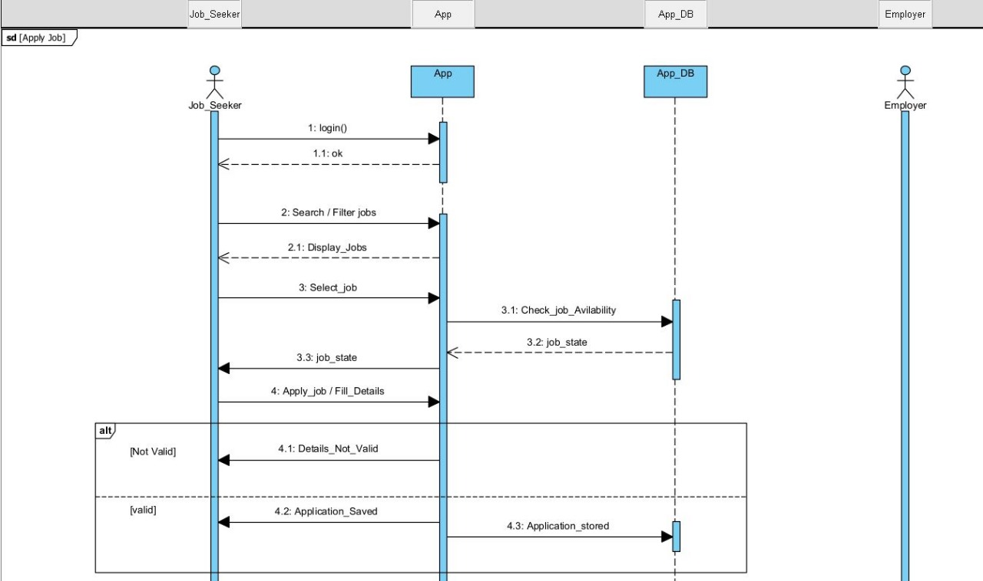

Slide 14
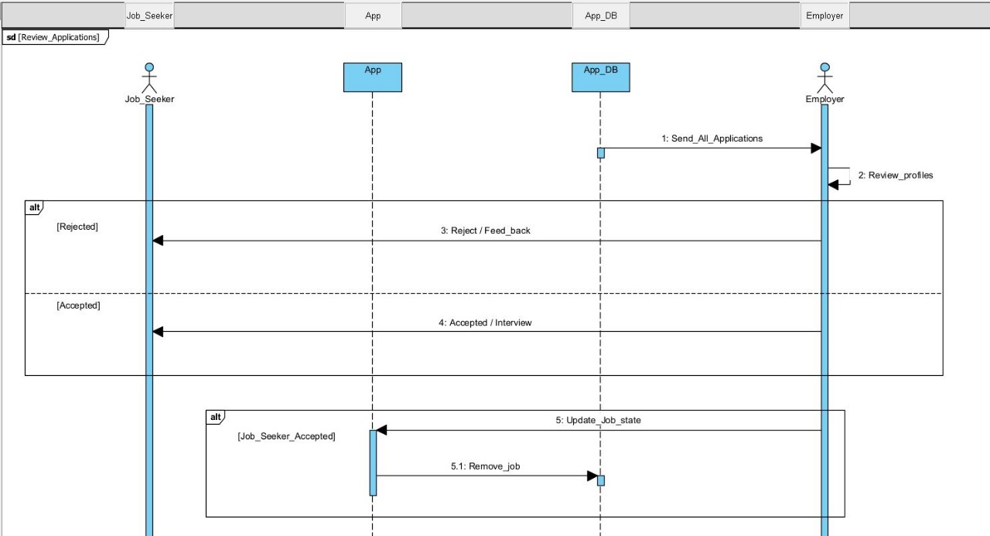

Slide 15
System architecture
Motivation for selecting a Layered Architecture:
A layered architecture is a common architectural pattern that divides an application into logical layers, each responsible for a specific set of functionalities. Each layer provides services to the layer above it and interacts only with adjacent layers. This architecture aligns well with the specified non-functional requirements in the following ways:
Performance.
Reliability.
Maintainability.

Slide 16
Component Diagram

Slide 17
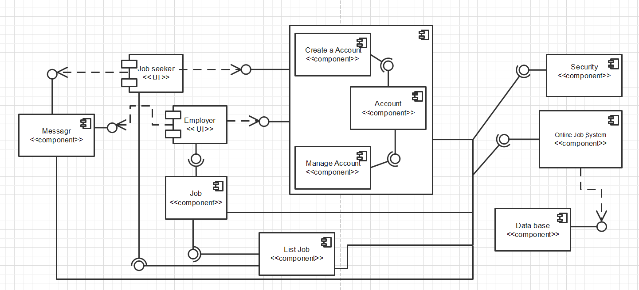

Slide 18
Class Diagram

Slide 19
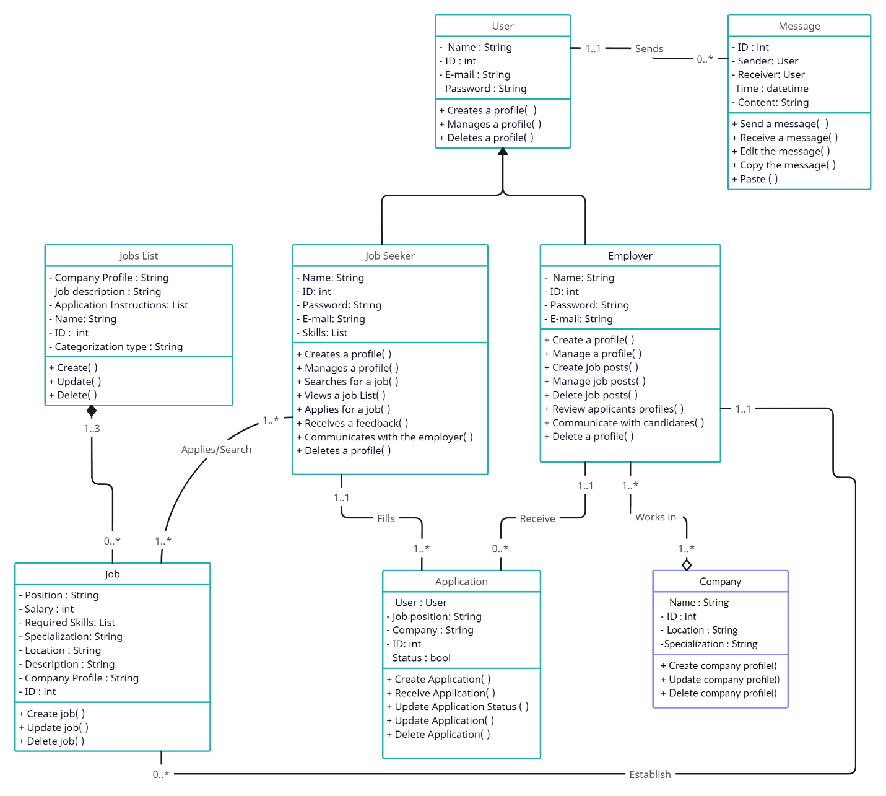

Slide 20
Revised Sequence Diagram
Post Job &Apply Job &Review Application

Slide 21
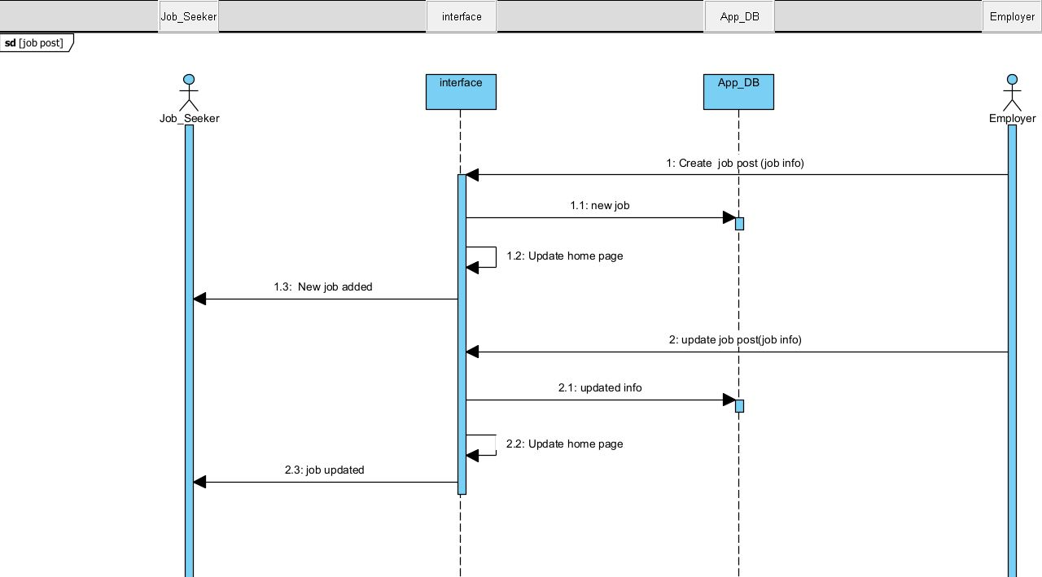

Slide 22
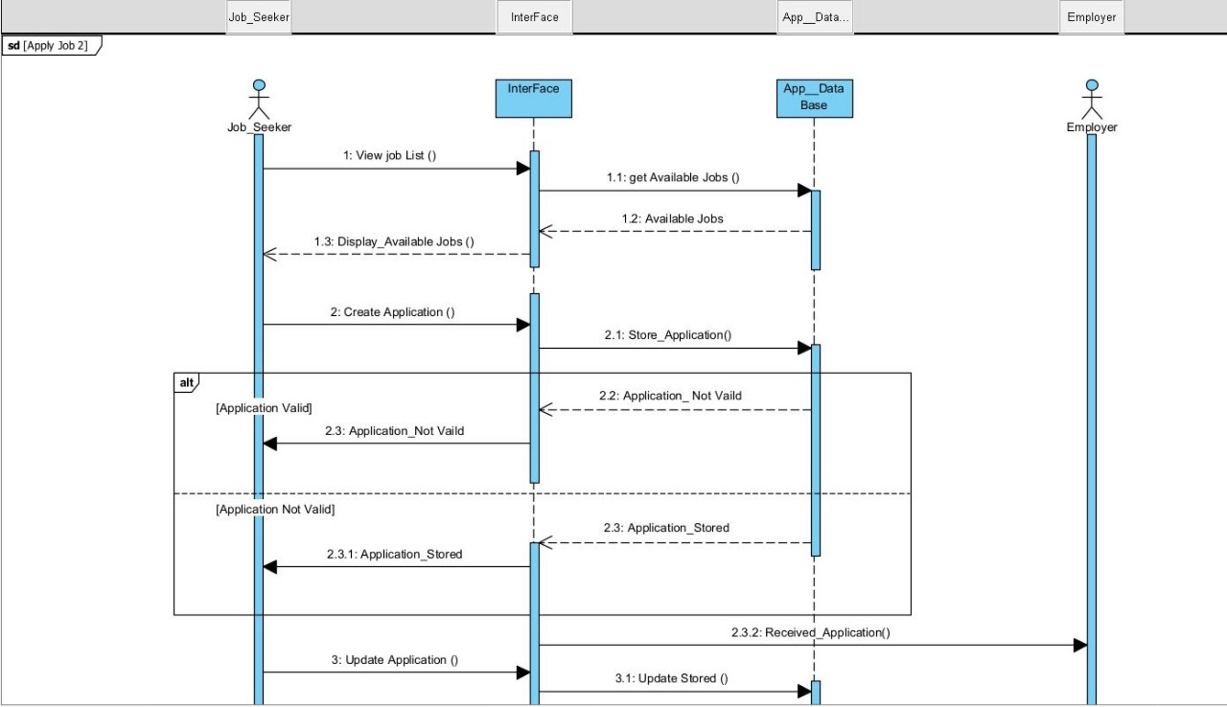

Slide 23
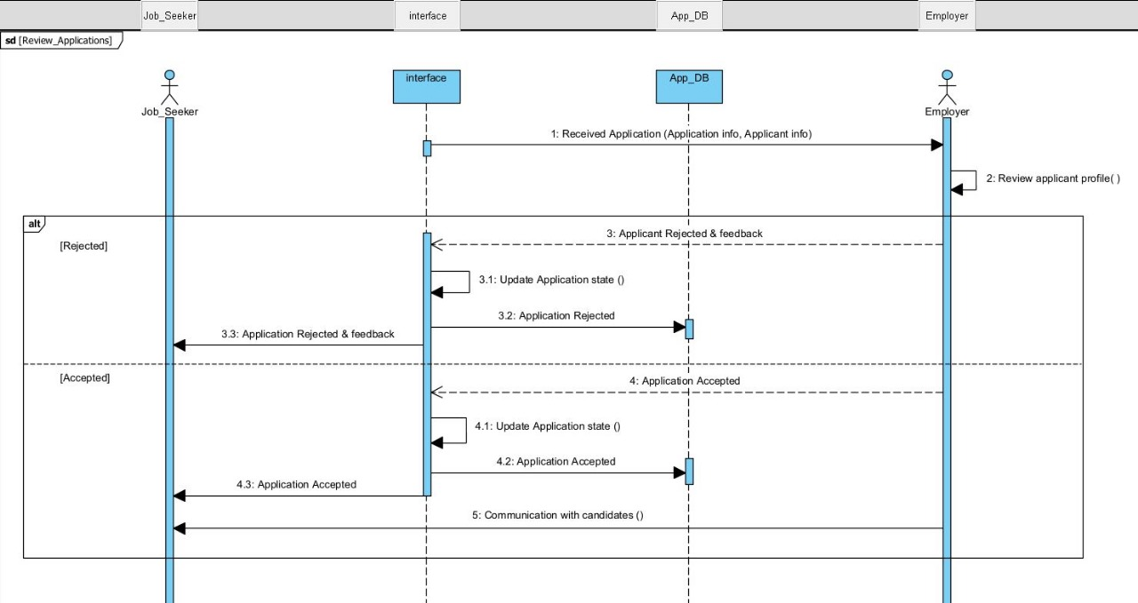

Slide 24
Activity Diagram

Slide 25
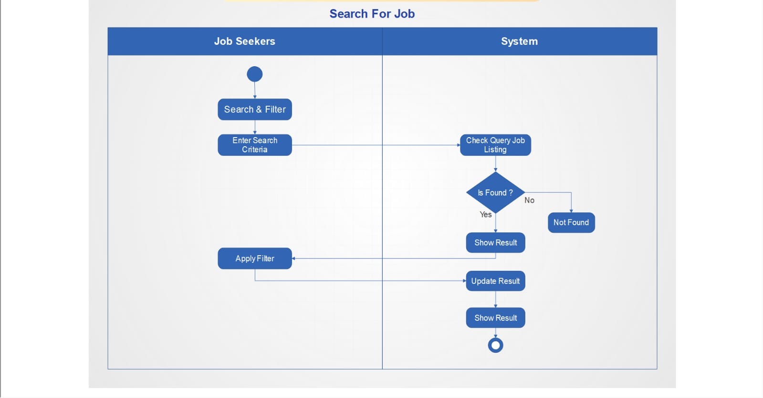

Slide 26
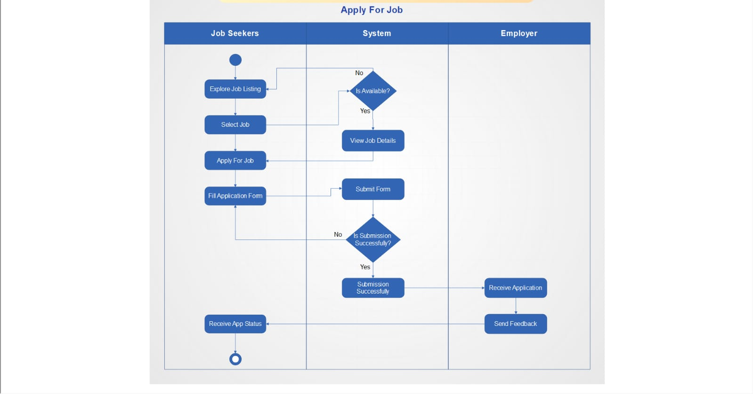

Slide 27
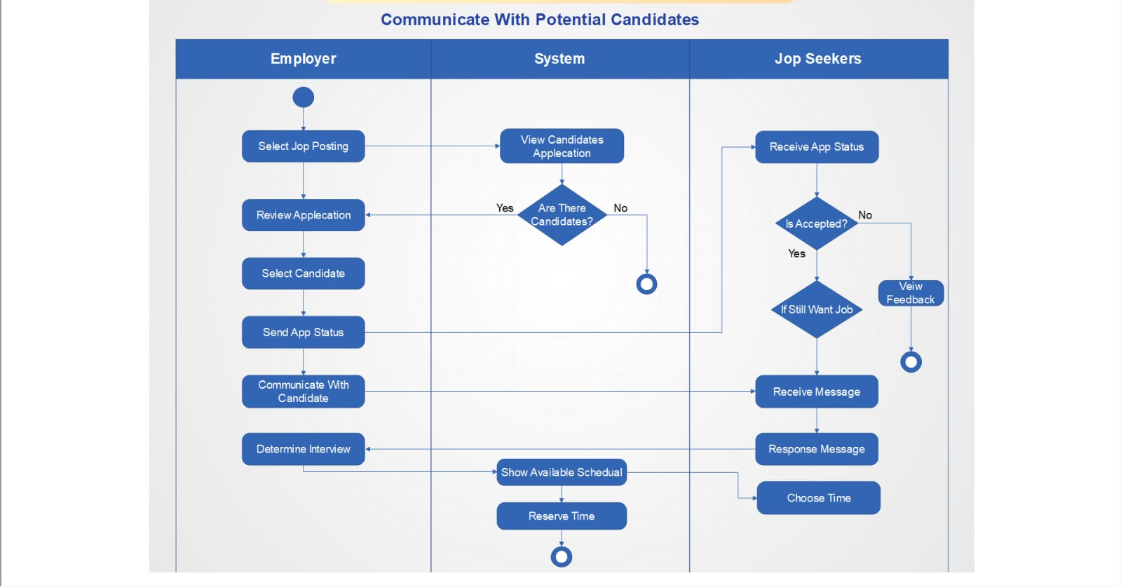

Slide 28
State-transition Diagram
Post Job & Search Job

Slide 29
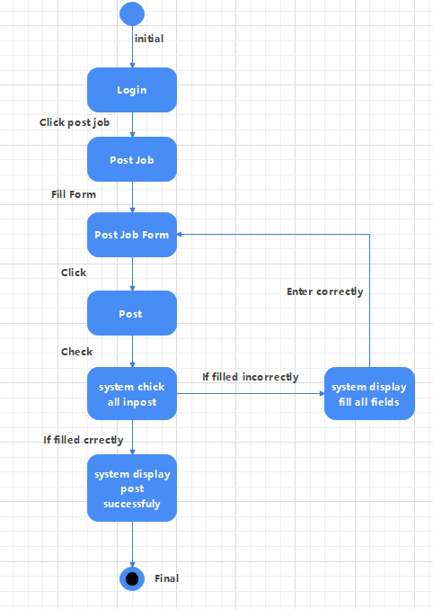

Slide 30
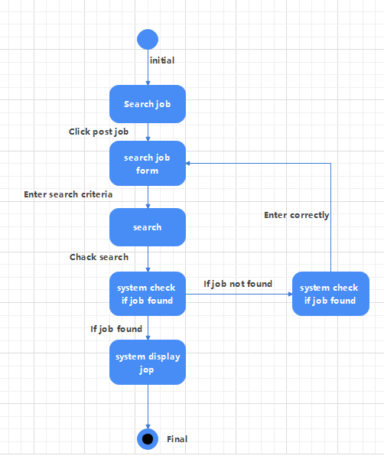

Slide 31


